Slide 1



AD & LDAP Hands-on

Slide 2
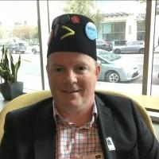
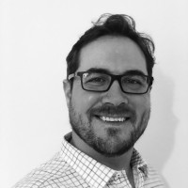
Aleem Cummins
SplunkTrust Splunk User Group London
VP EMEA, bitsIO Inc
Community Servant
Gregg Sullivan
AVP PS, bitsIO Inc
Community Servant

Slide 3

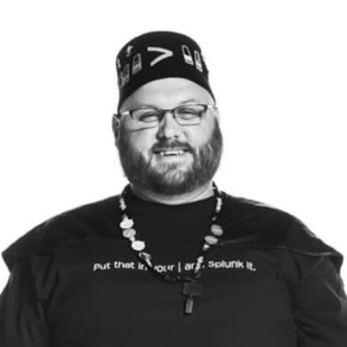
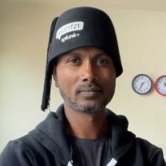
Study club for splunk
Aleem Cummins
SplunkTrust Splunk User Group London
VP EMEA, bitsIO Inc
Community Servant
Tony Reinke
SplunkTrust Nebraska 402 Splunk User Group Community Advocate and Platform Manager, Cribl
Community Servant
Suman Gajavelly
SplunkTrust Fort Worth Splunk User Group
CTO & Co Founder, bitsIO Inc
Community Servant

Slide 4
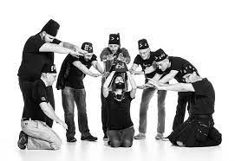


Insight - WHO, why, where and how
Born from SplunkTrust members and community leaders to energise community learning and rev up Splunk journeys.

Slide 5

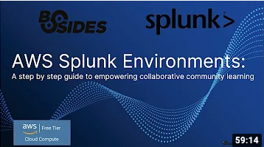

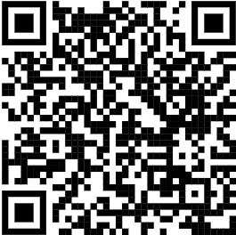


Slide 6

HOW : Easy as 1-2-3…….4
LOVE
1
2
3
4
Identify
Hot topics
Poll Community
Essential skills
R&D
Assemble heroes
Splunk docs
Work like crazy
Validate
Package
Code
SPL™
Video
Documentation
Share
User Groups
Study Clubs
Students
Talks and Demos

Slide 7
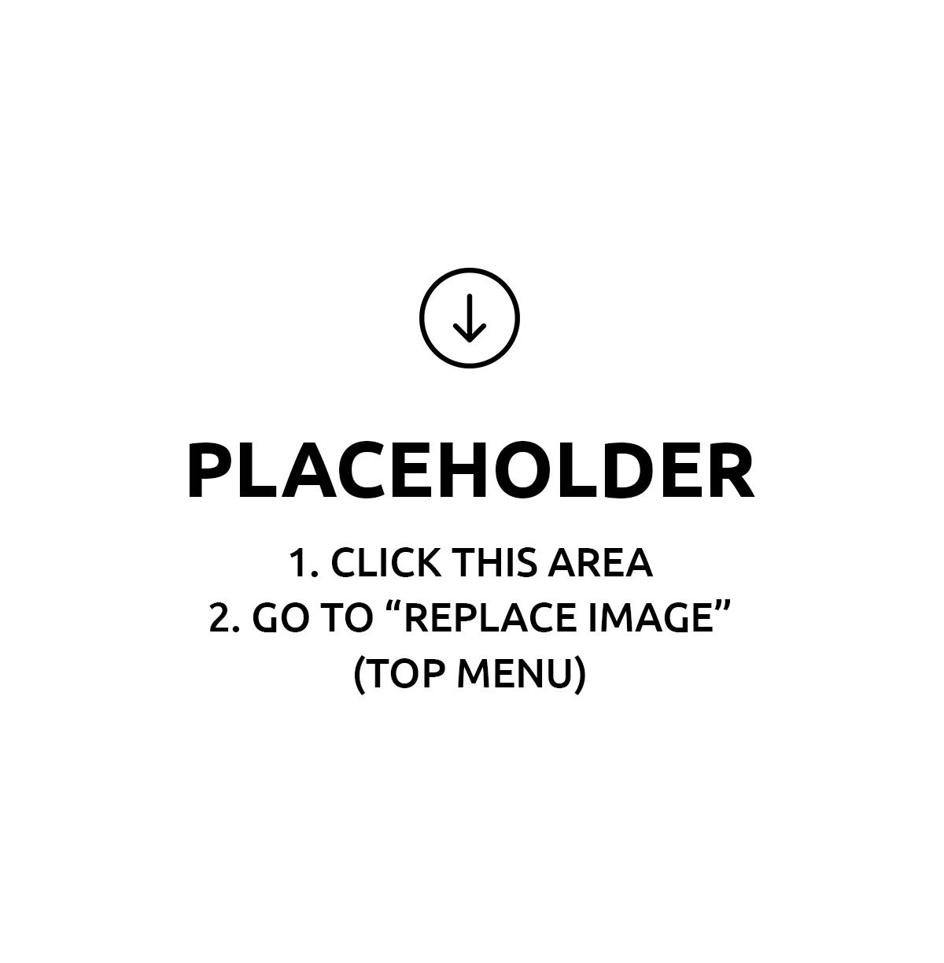
AD & LDAP!

Slide 8
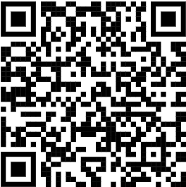
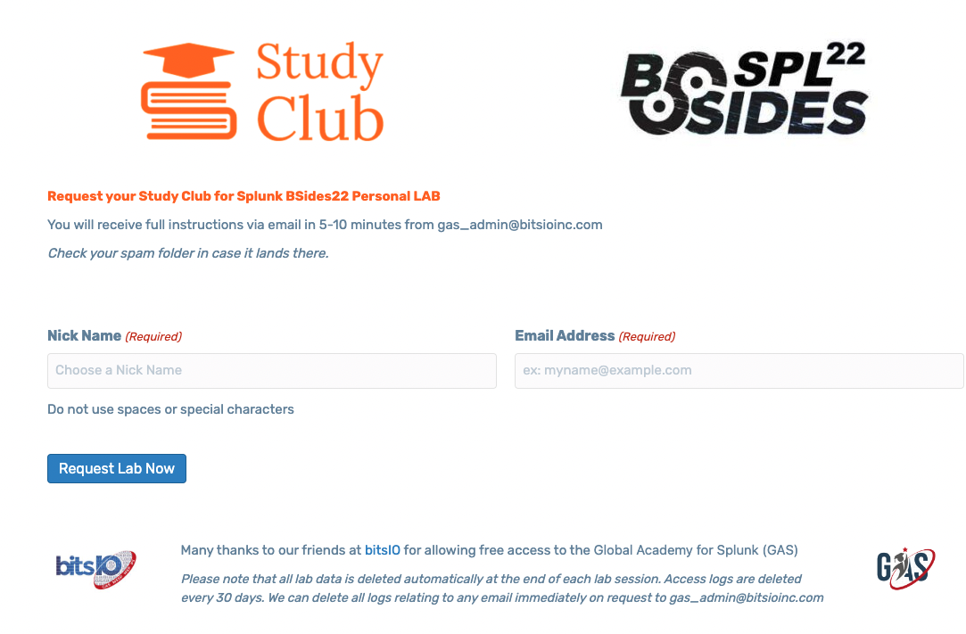




Request your personal BSIDES22 GAS lab environment
Place your screenshot here
Global Academy for Splunk
http://bsides22.gas.studyclub.community

Slide 9

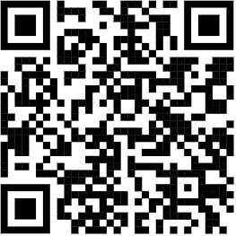

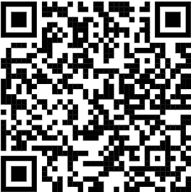


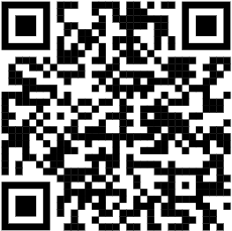
Study Club for Splunk - Get Onboard
As a Mechanic
As an Easy Rider
Holla out in Splunk community slack
@aleem
@treinke
@splnsuman
Stop by our Slack channel
Pull up at our GitHub garage
Request new practice labs
Tell your friends
#study-club-for-splunk
http://github.studyclub.community
http://splunk-slack.studyclub.community
http://splunk.studyclub.community

Slide 10
FireSIDE Chat!

Slide 11

THANKS!
Community Servants Rock !!

